Slide 1

Family Faith Formation:
Strengthening Families

Slide 2
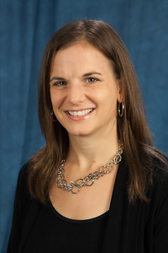

… equipping world-changing disciples of Jesus Christ
Rev. Dr. Tanya Marie Eustace
Director, Children’s & Intergenerational Ministries
teustace@umcdiscipleship.org
umc-intergenerational-ministry.com
Notes:
For those of you who do not know me yet- my name is Tanya and I am joining you all from Nashville this morning. I am the Director of Children and Intergenerational Ministries at Discipleship Ministries

Slide 3

This webinar is funded through World Service apportionment giving by local United Methodist congregations !
Notes:
A quick word of appreciation and gratitude. This webinar is provided and funded through your apportionment giving. Thank-you for generosity that make these resources possible!

Slide 4

Opening Prayer
Notes:
our prayer is adapted from a prayer in Judy Christie’s book: Hurry Less Worry Less for Families
Lord, thank-you for loving each of us and the many families we are called to be in ministry with. Please show us the right steps to take as we discern how to nurture and guide families in their faith formation. Guide us as we listen, wonder, and discern which direction we should go, what actions we should take, and how we might faithfully help those in our faith communities. Watch over us, our families, and the families in our faith communities- helping each of us feel your love in all that we do. In the name of Christ, Amen.

Slide 5
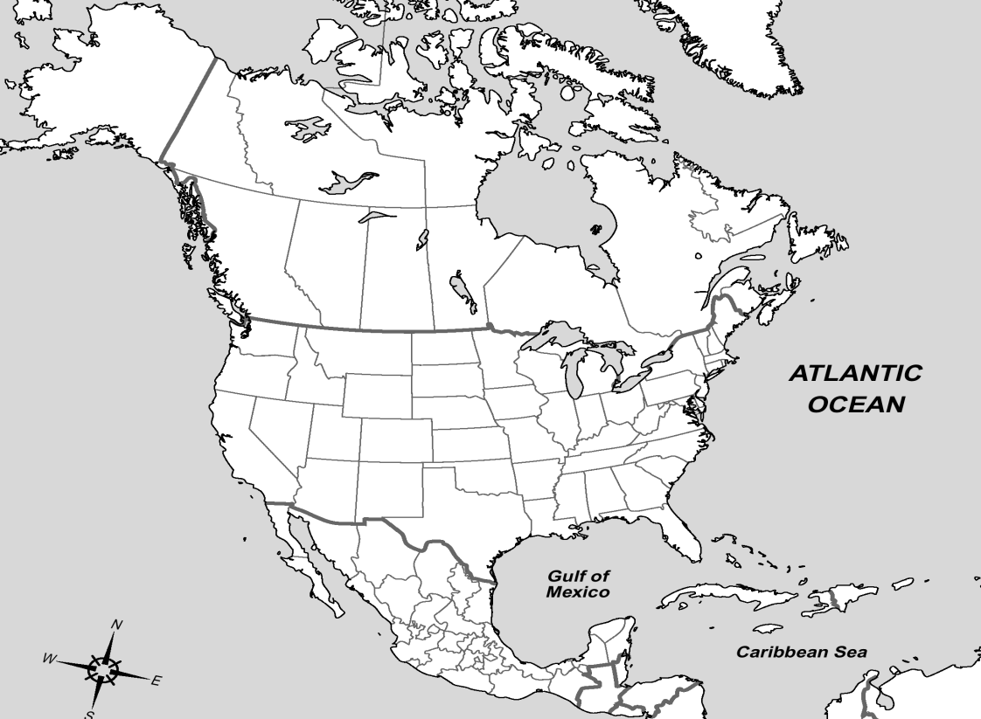
Where are you?
Notes:
As we begin our conversation I am always curious to see where everyone is joining us from…
Please click the arrow in the tool bar on the top left corner and then click anywhere on this map showing where you are located…

Slide 6

What is your role in ministry?
Notes:
Another piece of information that is helpful as we begin this conversation is for you to share your role in ministry…
Again- looking at the tool bar in the top left corner- click on the T, select a color, and then click on the slide to share your ministry focus
Are you a pastor, teacher, parent, mentor?

Slide 7

Today’s Guest Speaker
Juliana M Federoff
Global Ministries
Notes:
Juliana M. Federoff is Executive Secretary for the United Methodist Special Program on Substance Abuse and Related Violence (SPSARV) at Global Ministries. Juliana has an ecumenical theological education from St. Vladimir's Orthodox Theological Seminary (M.A., 2009) and Union Theological Seminary (S.T.M., 2010). She is passionate about ecumenism, women’s ministries in the Orthodox Church, hospital chaplaincy, and breaking the silence surrounding addiction in our churches so that we might lead whole, hope-filled lives.
Good morning Juliana- thank-you for being with us this morning….

Slide 8
Research-Proven Skills to Correct Errant Behavior in Youth
Through Parent & Youth Family Skills Training
Notes:
the research and the church-based ministry that brings families together once a week as they learn and develop skills that strengthen their families and help our kids stay drug and alcohol free.
The Strengthening Families Program has been around for over 30 years and has been implemented in 38 countries.

Slide 9
Name the images that come to mind when you think about addiction:
www.strengtheningfamiliesprogram.org
Notes:
So – WHY ME?
Addiction is an equal opportunity disease
Addiction is happening to OUR families. If you haven’t been personally touched by addiction – either suffering from addiction yourself or suffering from a family member’s addiction, then it’s your neighbor who is effect or the next person down. That’s how close this epidemic is to home.
Addiction happens more often to “so-called” nice families.
And, we are seeing a hug increase especially in opiate addiction in the US.
Heroin is primarily a middle to upper-middle class problem.
But addiction – to any drug, including alcohol – affects all of us no matter our education or socio-economic class.
Keep in mind that 1 in 5 (and this is a conservative number) 1 in 5 of our children in our pews have a parent or immediate family member who is addicted.

Slide 10
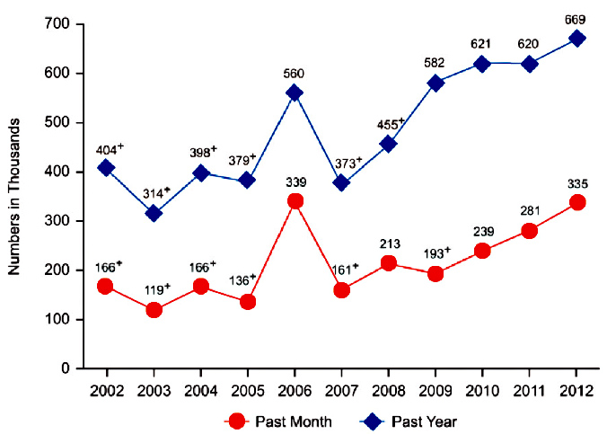

Past Month and Past Year Heroin Use Among Persons
Aged 12 or Older: 2002-2012
Source: National Survey on Drug Use and Health: Summary of National Findings, 2012.
Notes:
The number of people using heroin for the first time is unacceptably high, with 156,000 people starting heroin use in 2012, nearly double the number of people in 2006 (90,000).

Slide 11

Heroin: one of the most important drug abuse issues affecting communities across the US
⇨not just in urban areas
Suburban and rural areas:
⬆ amounts of heroin seized by officials
⬆ numbers of overdose deaths due to heroin use
People 18-25 seeking treatment for heroin abuse increased from 11% of total admissions in 2008 to 26% in the first half of 2012.
Notes:
Babies born with opiate addiction. Various regions across the US are naming heroin as the most or one of the most important drug abuse issues affecting them.
Heroin use is no longer just found in urban areas.
Several suburban and rural communities near Chicago and St. Louis report increasing amounts of heroin seized by officials
increasing numbers of overdose deaths due to heroin use.
Heroin use is also on the rise in many urban areas among young adults aged 18-25.⁸ People 18-25 seeking treatment for heroin abuse increased from 11 percent of total admissions in 2008 to 26 percent in the first half of 2012.
https://www.drugabuse.gov/publications/research-reports/heroin/scope-heroin-use-in-united-states

Slide 12
What makes you passionate about preventing substance abuse?
www.strengtheningfamiliesprogram.org
Notes:
Clearly, we WANT to do SOMETHING. Again, we SEE that given the statistics we MUST do something and we WANT to do something.
-- Prevention is the biggest bang for our buck. We save hundreds in treatment when we prevent addiction.
So, is there any good news to hear? Where does our HOPE lie?
**We CAN do something
**This WORKS
**This is simple (hard work, but simple)
**If you use SFP, you WILL see an impact.

Slide 13
Most addiction in America begins in adolescence…
…and can be prevented with skilled parenting
“...The median reported age of initiation of illicit drug use in adults with substance use disorders is 16 years, with 50% of the cases beginning between ages 15 and 18 and rare initiation after age 20.”
--Chambers, et. al. Developmental Neurocircuitry of Motivation in Adolescence: A Critical Period of Addiction Vulnerability American Journal Psychiatry 160:6, June 2003 P. 1041
www.strengtheningfamiliesprogram.org
Notes:
Again, we SEE that given the statistics we MUST do something and I see from our shared passion that we WANT to do something.
The good news is that we CAN do something.
Most addiction in American can be prevented with skilled parenting – and I would even say highly skilled parenting. Note: I am not saying average parenting. Or careful parenting. We are saying SKILLED. Average – good parenting isn’t enough today.
This stat simply means that if you wait until after age 20 to use an illicit drug, you are MUCH less likely to develop a Substance Use Disorder.
"The younger adolescents are when they start to drink, the more likely they are to engage in risky behaviors, including using drugs… having sex with six or more partners, and earning grades that are mostly D’s and F’s in school." (NIAAA Alcohol Alert, Jan. 2006, p.1)

Slide 14


Research proves SFP works
NIDA (1982-1986) research, 12 randomized control trials, 4 with independent research teams with up to 10 year follow-up studies found SFP works to change behavior & outcomes
www.strengtheningfamiliesprogram.org
Notes:
But where can we GET those skills? Is there any good news to hear? Where does our HOPE lie?
**We CAN get those skills from the Strengthening Families Program
**This WORKS
**This is simple (hard work, but simple)
**If you use SFP, you WILL see an impact.
Randomized (no self-selection)
Control = studying it against the control group (given nothing or given an alternative program) – sometimes people in the control group have a positive reaction

Slide 15

SFP Outcomes
SFP Parent Outcomes
⬆ parental involvement
⬆ positive parenting skills
⬇depression
alcohol & drug use
SFP Child Outcomes
⬇ depression
⬇ conduct disorders
⬇ aggression
drug use
⬆ cooperation
⬆ number of pro-social friends
⬆ social competencies
⬆ school grades
SFP Family Outcomes
family conflict
⬆ family bonding
⬆ positive communication
⬆ family organization—family meetings, chores done
- Improved parent/child relationship
⬆ family strengths and resilience

Slide 16

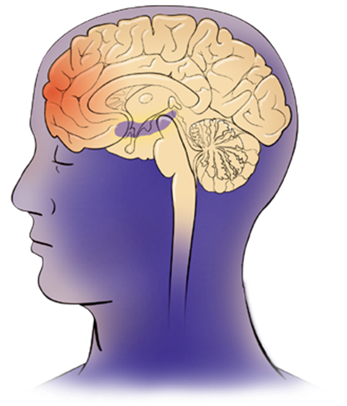


Teens, through their choices and actions, have the power to direct the development of their own brains.
Dr. Jay Guidd National Institute of Mental Health
SFP 7-17 works by training parents and youth in pro-social skills and behaviors that trigger feel-good brain chemicals.
www.strengtheningfamiliesprogram.org
Notes:
Training is PRACTICE:
Muscle memory
Makes you want to do it again
thus enhancing self-esteem and family bonding

Slide 17

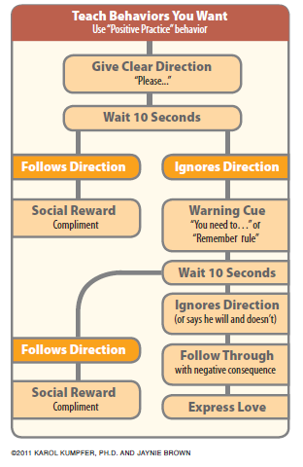
LESSON 2 I-Messages:
allow you to 1) state your feelings or needs respectfully, 2) explain why you feel that way, and 3) what you want or what bothers you without blaming.
Notes:
There are also worksheets for problem solving and pre-problem solving, considering situations your children might face.

Slide 18
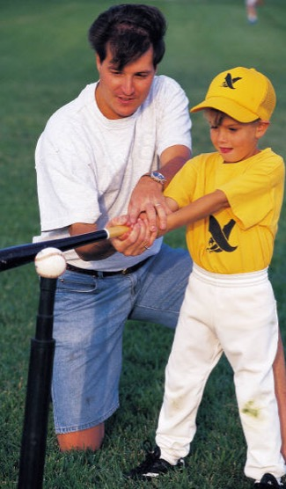
Family-Centered Intervention Outcomes Improve Over Time
Whereas youth-only programs have reduced outcomes over time, family programs have improved outcomes.
School-based, education-based programs do NOT work.
WHY US?
jfederoff@umcmission.org
Notes:
You might ask WHY US? WHY THE CHURCH?
School-based, education-based program do NOT work.
Is there any place more family-friendly, more family focused than the church?
The church has always supported and championed the family b/c the church sees that most often it is through the family that our children come to know Christ and become faithful disciples.

Slide 19
Family factors that Protect Kids
Strong, loving parent-child bonds
Functional, well-managed home
Mild, consistent discipline
Clear rules against A.T.O.D. use
Monitoring of child’s activities & friends
High expectations; involved parent
School attendance and success
Family customs & traditions
Parents set a good A.T.O.D. example
Neighborhood attachment
jfederoff@umcmission.org
Notes:
Let’s take a look at what helps to protect our children
This is more than providing love. 3 things: Bonding, boundaries, monitoring.
High expectations. Including setting goals and making contracts to CHANGE behavior. This program teaches children how to change. There are sections on delayed gratification, Accepting consequences calmly, Receiving feedback calmly.
Clear, stated rules. Not “understood.”
Monitoring: following up on the rules, enforcing and providing NATURAL consequences rather than the child simply “DOING TIME”
This takes some foresight, some planning, and some sharing of ideas/brainstorming WITH your spouse, children AND other families.

Slide 20
SFP Targets
Risk & Protective Factors
with 3 types of skills:
BONDING skills
(create warm, loving relationships)
2. BOUNDARIES skills
(clear firm rules and consequences)
3. MONITORING kid’s activities skills
(to see that they always stay in alcohol
& drug-free social environment)
jfederoff@umcmission.org
Notes:
*These are the skills that have been shown to have the most influence on keeping teens from experimenting.

Slide 21
WHY NOT?
Why not help our families become happier?
Why not make our children happier?
Why not increase family cooperation?
Why not reduce stress in our lives?
Why not reduce substance use?
This takes hard work, but it is simple.
The Strengthening Families Program will make a measurable, long term, life changing positive impact.
jfederoff@umcmission.org
Notes:
These are our goals afterall.
This is what Art did. Went to SAMHSA and looked at all their so-called evidence-based programs. Some prevention programs cost 10’s – 20’s of thousands of $ to implement. Some were tested internally. Some provided some positive impact, but the impacted didn’t last or wasn’t tested over a long period of time. Some weren’t practical for a church or a community to implement. Some REQUIRED clinical professionals.
Why spend our energy on anything other than something that has been proven to work?

Slide 22

WHY NOW?
The original program, developed in 1982, was expensive to implement and required a clinical professional to run each weekly session for families.
This updated version – the facilitated DVD discussion group – added in 2012 reduces the cost significantly, making it affordable for communities and able to be implemented by trained volunteer facilitators, rather than group therapists.
jfederoff@umcmission.org
Notes:
15 Strengthening Families Program facilitator trainings to help alleviate the problems of substance abuse, addiction, and related family violence among their congregations.
The facilitator training is provided on-site and lasts two full days. Global Ministries funding covers the cost of providing the trainer, copies of the curriculum and the DVDs. What’s needed from the local organizers is a site large enough to accommodate approximately 20 participants. It’s also helpful if the local organizers can arrange for coffee breaks for the two-day training.
A detailed script for each of the lessons provides the facilitator with precise instructions about what to say and how to address common issues. It’s the combination of the 2-day training, a careful review of the materials, an easy-to-follow DVD and script that have made it possible for volunteers to be able to successfully implement The Strengthening Families Program.

Slide 23
A Typical Weekly DVD Family Discussion Group
Parents and kids meet together at a school or church and watch the DVD together
Led by trained Family Coach
DVD paused and Discussion Questions asked at specific spots
Families answer the ?’s and practice skills
To be successful you will need:
  Handouts
  Trained Family Coach (2 preferred)
  Parents able to discretely submit questions on
  problems they may be having
www.strengtheningfamiliesprogram.org
Notes:
Therefore, the Strengthening Families Foundation proposed conducting 15 Strengthening Families Program facilitator trainings for the United Methodist Special Program on Substance Abuse and Related Violence in multiple location sites around the US to help alleviate the problems of substance abuse, addiction, and related family violence among their congregations. In March 2016, this proposal was approved for funding by the Global Ministries board of directors.
The facilitator training is provided on-site and lasts two full days. Global Ministries funding covers the cost of providing the trainer, copies of the curriculum and the DVDs. What’s needed from the local organizers is a site large enough to accommodate approximately 20 participants. It’s also helpful if the local organizers can arrange for coffee breaks for the two-day training.
After receiving the training and reviewing the materials, the trainees, working in pairs or groups of three, will be prepared to implement the 12-session Multi-family DVD Discussion Group. In each session, the facilitators will walk the families through the DVD. Together they watch the DVD, being prompted by the DVD to stop at various points of the lesson in order to practice various skills. A detailed script for each of the lessons provides the facilitator with precise instructions about what to say and how to address common issues. It’s the combination of the 2-day training, a careful review of the materials, an easy-to-follow DVD and script that have made it possible for volunteers to be able to successfully implement The Strengthening Families Program.

Slide 24



WHAT’S NEXT?
1) Find 2 others with your same level of passion
2) Contact me:
  jfederoff@umcmission.org
  212-870-3883
For more information about the Strengthening Families Program:
  www.strengtheningfamiliesprogram.org
THANK YOU

Slide 25

Questions?
Notes:
Now we invite you to type your questions on the white space provided or in the Q&A box located on the right side of your screen.

Slide 26

Discerning Together
Next Steps

Slide 27

RESOURCES
umc-intergenerational-ministries.com
Living with the Holy
(Connecting with God every day)
Faith Formation resources
(Lists of resources to strengthen your ministry)
Family and Leader Newsletter
Notes:
It is also our job to provide fresh ideas and encouragement along the way.
Family newsletter: 4 ways to connect to God and each other every month.
http://www.umc.org/what-we-believe/get-your-spirit-in-shape-family-devotions podcast
http://books.upperroom.org/book/scrambled-starts/

Slide 28

UPCOMING WEBINAR

Slide 29



Stay in Touch
teustacegbod
teustace@umcdiscipleship.org
(877) 899-2780 EXT. 7014
Blog: http://umc-intergenerational-ministry.com/
Facebook Groups: UMC Intergenerational Ministries &
Family Faith Formation
Notes:
https://www.facebook.com/groups/108689069185062/

Slide 30

Go in Peace…
to love and serve the Lord...
Together.

